Slide 1
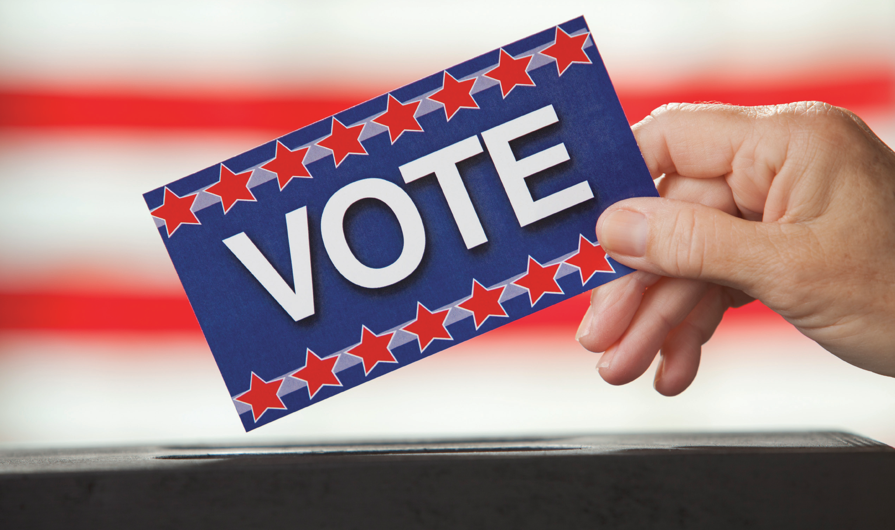
Opportunities in New York State
Presented by the League of Women Voters of NYS Education Foundation and the League of Women Voters of NYS
Increasing Voter
Participation

Slide 2
Voter Access in New York
One of the lowest participation rates in the nation
No major voting reforms implemented (one of only a few states without major changes)
Constitutional changes needed for some reforms (Election Day registration and some types of early voting)
Restrictive registration requirements, including the sit-out rule for primaries

Slide 3
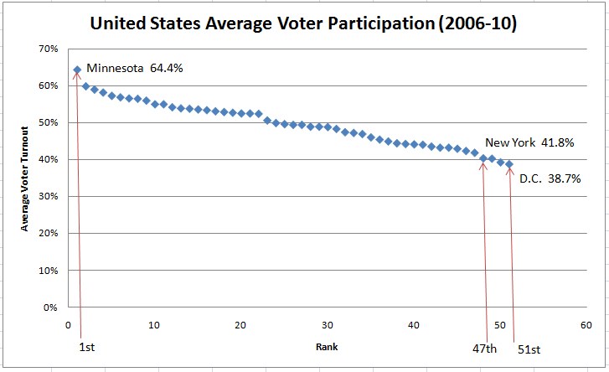
New York Near the Bottom

Slide 4
New York vs. Other States
 | Types of Voting Reforms
 | Reform | States | New York?
Alternative Poll Access | Early In Person Voting | 32 plus D.C. | No
 | No Excuse Absentee | 27 plus D.C. | No
Ease of Registration | Same Day | 8 | No
 | Online | 9 | No
Primary Type | Open/ Partially Open | 25 | No
 | Closed | 12 | Yes
Updated and adapted from: Bloomberg, M. “2010 Mayor’s Report on Voter Access in New York”. December 2010
Notes:
In addition to the 8 states that currently have EDR, two more, North Carolina and Ohio, allow voters to register and vote during the early voting period.
9 states currently offer online voter registration, California and Maryland have passed legislation but not implemented it yet.

Slide 5
Possible Solutions for NYS
Voter registration modernization
Election Day registration (EDR)
Early voting
Better ballot design, voter education and poll worker training

Slide 6
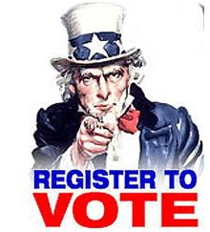
Voter Registration in NYS
Paper-based system prone to error
Long period between registration and voting eligibility
Even longer to change parties and participate in primaries
Sit-out rule
Notes:
Voter registration deadline is 25 days, 10 days required in Constitution,
Party affiliation has to be changed by 25 days prior to the date of the preceding general election day
Party affiliation, 20 of 25 states that require party affiliation to vote in primaries allow changes within 30 days of voting.

Slide 7
Voter Registration Modernization Innovations in Other States
Automated
Safety Net for Errors
Online
Election Day
Notes:
The Brennan Center did an extensive study of paperless voter registration in 2010. This report cited a comprehensive national study showing that up to 3 million people were kept from voting in 2008 due to registration problems.
Automated registration refers to how State election officials electronically register consenting eligible citizens
Once an eligible citizen is on a state’s voter rolls, that record is also electronically updated
Eligible citizens can correct errors on the voter rolls before and on Election Day.
Nine states currently offer online registration.
Eight states have election day registration.

Slide 8
How Paperless System Works Through DMVs
DMV Collects Information
DMV Transmits Information
Election Officials Process Information
Adapted from: Brennan Center for Justice “Voter Registration for the 21st Century”
Notes:
The states that have adopted automated registration at their DMVs all follow basically the same process.
Step 1: When a customer wishes to register to vote and affirms her eligibility, DMV officials enter her information into the DMV database system.
Step 2: The statewide voter registration database system collects voter registration information from the DMV system and sends it to local election officials for review.
Step 3: Local officials review the new registrations.
Step 4: When local officials accept the registrations, they are posted to the voter rolls.
Automated registration has become increasingly popular. Seven states currently have fully automated systems. By this, we mean the entire process is paperless, so that all information election officials need is transmitted electronically in a format that can be uploaded into their databases. Ten states now have partially automated systems. By this, we mean that agency officials transmit some information electronically, but they have not completely eliminated the transmittal of paper forms (such as for signatures) or local data entry. Arkansas and Texas, listed here as partially automated, are currently moving toward full automation and they may have completed their work by now.

Slide 9
Advantages of Paperless System
Cost effective
More accurate
Easier to update
Boosts registration rates
Notes:
Clear benefits of paperless system. Registration innovations have earned praise from both parties.
None of state officials interviewed by the Brennan Center found any reliability or security problems with paperless registration.

Slide 10
Infrastructure Already in Place
HAVA statewide voter registration database
Other lists computerized
Could be easily done in New York
Notes:
The infrastructure for modernization is now in place in every state:
Every state now has a statewide voter registration database.
Most other reliable government lists are now in computerized databases.
The Selective Service builds its registration lists largely through automated registration and data transfer from government agencies in every state, and it has been doing so for a number of years.
Moving to paperless registration in New York would not require a constitutional amendment or major statutory changes.

Slide 11
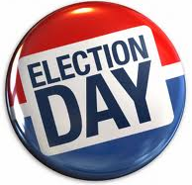
Election Day Registration (EDR)
Already implemented in 8 states
Higher participation rates
Decreased reliance on affidavit ballots
Would require constitutional amendment in New York
Notes:
Eligible voters who do not appear on rolls complete new voter registration application on Election Day and vote regular ballot.

Slide 12
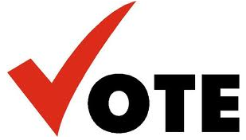
Security Concerns with EDR?
Evidence Lacking
States with EDR require residency and ID proof
Post-election audits
Notes:
Have to attest to identity face to face with election officials.
Heavy penalties, voters must document identity and sign oath.

Slide 13
Types of Early Voting
Types of Early Voting Systems
Early Voting Systems | States Where Used
No-Excuse Absentee | 27 states (plus DC) including at least 7 states (plus DC) that allow "permanent" status
Early In-Person Voting (EIP) | 32 states (plus DC) allow early voting in-person voting
Solely Vote-by-Mail (VBM) | Oregon and 38 of 39 counties in Washington

Slide 14
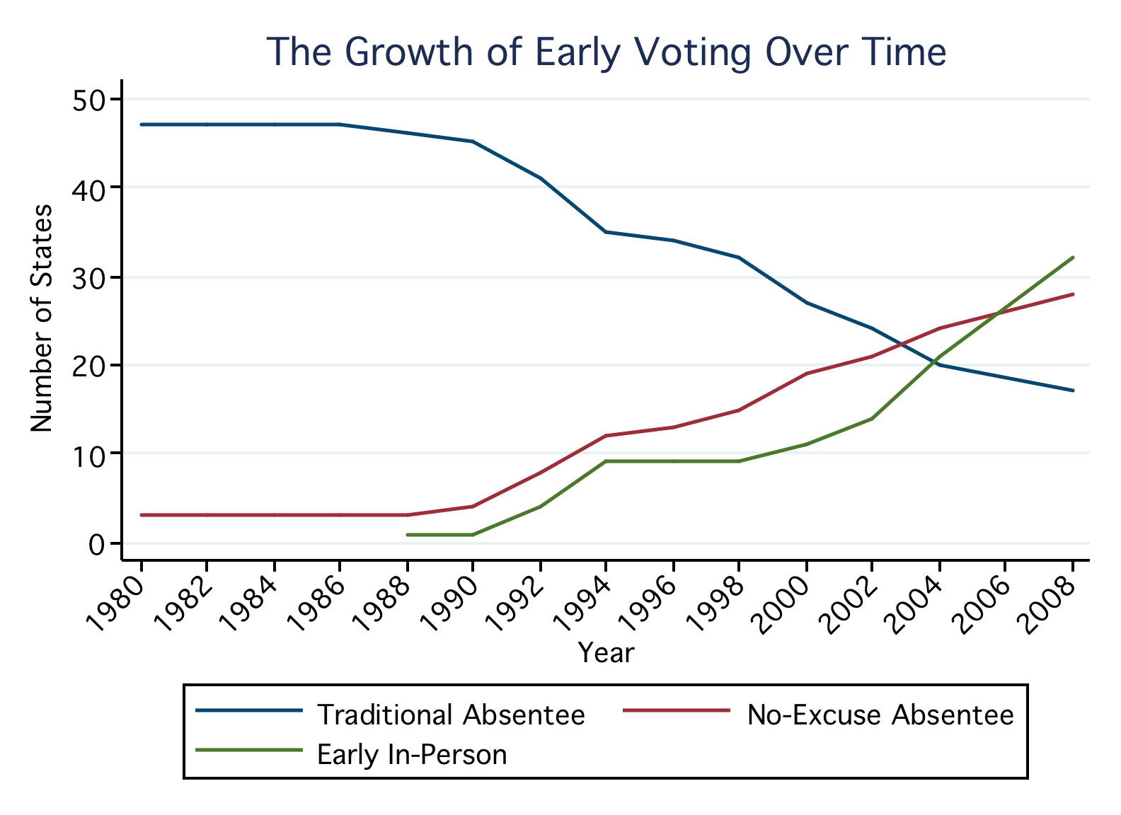
Adapted from: Reed College Early Voting Information Center”
Notes:
Three main legal regimes out there:
Traditional absentee balloting, mainly remaining in the NE.
No excuse absentee balloting, first appeared in California in 1978 and as we will see in a moment, accelerated in the 1990s.
Finally early in person voting, first pioneered by Texas and similarly grew through the 1990s, really exploding after 2000.

Slide 15
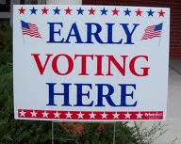
Arguments for All Types of Early Voting
More convenient
Increased voter satisfaction
May increase voter participation
Other possible advantages:
More accurate ballot counting
May reduce administrative costs
Notes:
All scholars agree that early voting increases the validity of the election but are conflicted on the cost savings and increasing participation.

Slide 16
General Early Voting Concerns
Mixed results on increasing voter turnout
Fails to overcome demographic barriers to voting
Upfront cost for election administrators
Ballot security
How long a period for Early Voting?
Notes:
Either absentee or EIP. Prolongs the election cycle and raises the cost of running a campaign
Raising costs- candidates now have to focus for example on the ‘2 weeks’ before election day and treat every day as if it were a poll day. This can drastically increase election coffers
Early voting periods range in length from 4 days to 45 The average is 19 days.

Slide 17
Voter Turnout Debate
Overall participation increase may only affect certain demographics
Some states have seen dramatic increases of almost 10%
Others have witnessed an actual drop in participation
Success of early voting appears to depend heavily on the demographics and the scope of the election
Notes:
Sudden and forced VBM in California saw a drop of over 10% in participation.

Slide 18
Equal Accessibility Concerns
Inequities in early voting implementation
How many sites and how many machines?
Disabled voters still face accessibility problems
Similar demographics with early voting sites and Election Day
Notes:
Transportation challenges to early voting poll sites
Lower-income communities suffer from poor mail service and weak voter registration

Slide 19
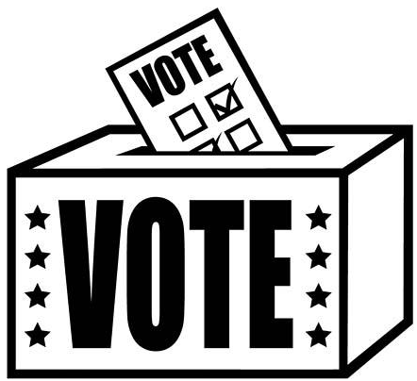
No-Excuse Absentee Voting
Allows citizens to acquire an absentee ballot without any justification
Very successful in California
Provides dramatic increases in absentee voters
Would decrease costs on Election Day
Paper trail provides accountability
Notes:
California
-2002- 25% of voters cast their ballots through absentee voting
Would result in more accurate vote records –recountable
Decreases costs because fewer people are voting on Election Day

Slide 20
Drawbacks of No-Excuse Absentee Voting
Would require a NYS Constitutional Amendment
Demographic barriers to voting remain
Ballot security
Notes:
Studies show the same demographics utilize absentee ballots- older and more educated populations, might not actually stimulate voter participation
Absentee ballots have always had security concerns

Slide 21
Early-In-Person Voting (EIP) - Voting Centers
Permits voters to cast vote early- either at traditional polling places or conveniently located voting centers
Lessens traffic and wait times on Election Day
May help with “mobile” populations in urban areas or college towns
Notes:
One study found that placing voting centers in convenient places such as shopping malls and super markets greatly increased voter turnout
2004- more citizens in Texas voted early than on Election Day.
Clark County Nevada (Las Vegas) had a travelling Poll site which would drive into different towns and allow people to vote.
In urban areas or college towns where voters often move to new residences and are not registered with the proper polling place
Supermarkets, shopping malls, traveling poll sites

Slide 22
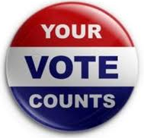
EIP Concerns
Doesn’t overcome the barrier of people having to physically get out and vote.
Problems with staffing at and additional
costs of voting centers
Availability of suitable polling locations
Demographics that show up to vote early are almost identical to those who vote on Election Day.
Notes:
The localities were not a problem because you voted with the proper type of ballot for your original precinct. However, this means that different ballots have to be available at the EIP voting centers.

Slide 23
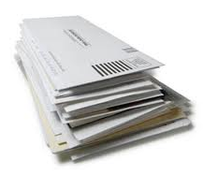
Vote-by-Mail (VBM)
Provides a solid paper trail
Random ballot auditing can combat fraud
Lowers election costs
Used in Oregon entirely and almost all of Washington state
Notes:
Oregon estimated it saved 17% on costs by switching to all VBM
Would require all registered voters to mail in a ballot, eliminates the need for polling places
Oregon has had a slow 20 process to finally adopt a full VBM system- started with no excuse absentee and then small scale elections allowing VBM. Eventually the entire state was all-VBM
-VBM serves to retain voters more than mobilize voters
-Oregon is the only state to mandate VBM status, but other states provide permanent VBM status as an option for voters
Oregon reports 6% increase over 3 presidential elections, but scholars see inconsistent results in studies.

Slide 24
VBM Concerns
Security and fraud concerns with VBM elections-LWVUS SARAT Criteria:
Secure
Accurate
Recountable
Accessible
Transparent
May have negative participation effects if VBM is mandatory
Has not had significant success in low-income communities

Slide 25
New York Ballot Issues
Poor ballot design and confusing instructions
Multi-language ballots lead to small fonts and convoluted layout
May create distrust in voting process
Has been some resistance in New York to sample ballots being online

Slide 26
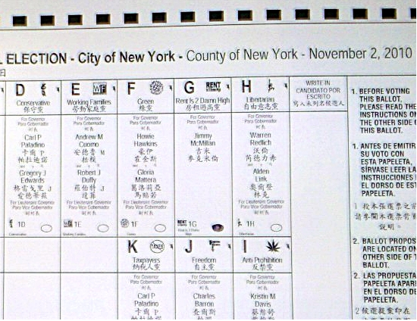
New York City Paper Ballot

Slide 27
Fixing the Ballot
Simple and cost effective to fix
Follow guidelines for effective ballot design
Clarifying design, including page numbers and layout
Using clear and simple language on both instructions and referendums
Wouldn’t require complex legislation or constitutional amendment

Slide 28
Voter Education And Poll Worker Training
BOEs posting online ballots, educating voters
Paper voter guides
Electronic voter guide
Better and standardized poll worker training

Slide 29
Possible Steps
Short term
Voter registration modernization
Better ballot design
Improved poll worker training
Online sample ballots
Long Term
Election day registration
No-excuse absentee voting
Early voting

