Slide 1
Making Public Policy (Laws)
in New York State

Slide 2
Anticipatory Set
What are two problems that you would like to see fixed at your school?
(Write on your worksheet)

Slide 3
Anticipatory Set - Part II
Now that you have identified problems, create a solution for each problem that you believe would fix these problems (this could be a new rule, but it doesn’t have to be).
(Write on the gray boxes on your handout)

Slide 4
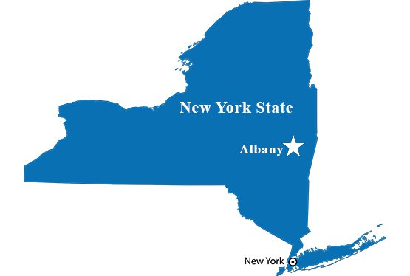
For 6 months each year, the Legislative Branch and the Executive Branch meet in Albany to propose ideas/solutions (Bills) to problems and pass the ones most supported into New York State Laws.

Slide 5
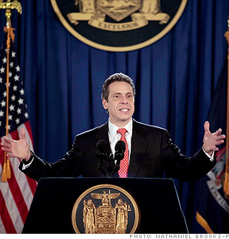
B. The head of the Executive Branch is the Governor. His role in our state is similar to the President in our Federal Government.
Governor Andrew Cuomo

Slide 6
C. The New York Legislative Branch has two chambers. The New York State Assembly and the New York State Senate.
D. There are 150 members in the Assembly and 63 in the Senate.

Slide 7
E. In order for a bill (idea or solution) to become law it must pass both the Assembly and the Senate and then be signed into law by the Governor.
NEXT: Draw a diagram in the box on your handout that represents steps in the New York State lawmaking process (letter E).

Slide 8
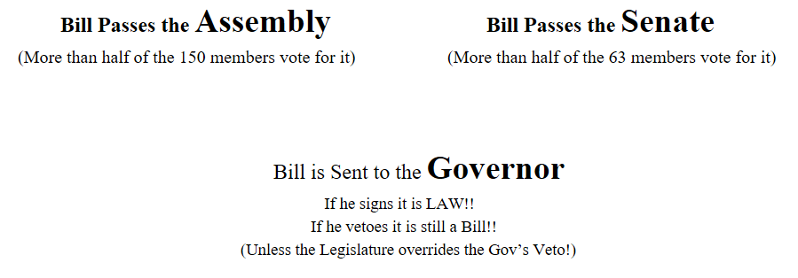
-How is this an example of checks and balances?
-How does this process make sure the citizens of New York have a say in the Public Policy (lawmaking) process?

Slide 9
There are three steps a Bill (idea) must go through to pass through both the Senate and Assembly on its way to the Governor for Signature. (Fill out the notes in the middle column on your handout!)
Assembly | *A Bill Must pass each of these steps in both the Assembly and Senate to be sent to the Governor for signature! | Senate
1. Bill Introduction | Members submit their idea and it is put into Bill Form and Given a Bill Number (A.15 or S.171) | 1. Bill Introduction
2. Committee Process | Every Bill is then sent to the Committee of Members that specializes in that topic to review the bill (how much will it cost, what are the pros/cons, etc). | 2. Committee Process
3. Floor Vote/Debate | Most Bills don’t make it out of Committee. The ones that do get debated and voted on by the all the members. If a Bill gets a majority of the members to support it passes through the chamber. | 3. Floor Vote/Debate

Slide 10
When a Bill is introduced it is put in Bill form and given a “Bill Summary” like the one below so New Yorkers can understand what the Bill does.
Assemblywoman Rozic introduced the Bill and it was given a #.
Bill Summary
Bill #: A.1323
Sponsor: Rozic
Co-Sponsors: Blake
Actions:
1/3/2018 referred to labor
2/14/18 referred to rules
5/22/18 ordered to third reading calendar
5/24/18 passed assembly
Summary: This bill requires employers to provide employees with consistent and predictable work schedules, increasing the ability of low-wage earners to plan important aspects of their lives and preventing work schedules that set forth less hours than expected.
The Bill passed through 2 committees (Labor) and then (Rules).
The Summary Explains what the Bill would do if passed into law.
When the Bill got out of Committee, it was Voted on (and passed) by the 150 Assembly members)

Slide 11
Finding Bills That Interest You...
1. Go to the website: http://nyassembly.gov/leg/
Fill in an number from 1 to 11000. Keep putting in numbers until you find a Bill that interests you..
When you find a bill you like you should click on the number link and then click on “Summary”, “Actions” and “Memo.” (to get the information you will need on the bill).
2. Use the information to fill out the 1st Bill Summary on the handout.
3. When you have finished your first Bill Summary you should find 2 more bills you are interested in and continue to complete the handout.

Slide 12
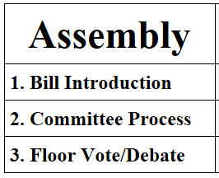
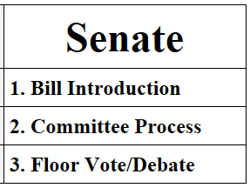
New York State Public Policy Process

Slide 13
Part II:
How does the Assembly work?

Slide 14
Rise to Question | Members of the Assembly ask a question of the Bill’s sponsor (how much would this cost?; what interest groups oppose this bill?; Has this been tried in any other states or countries?)
Rise to Support | Members of the Assembly ask their Assembly colleagues to support this bill and then give brief arguments supporting their opinion.
Rise to Oppose | Members of the Assembly ask their Assembly colleagues to oppose this bill and then give brief arguments supporting their opinion.

