Slide 1
New York State Rights, where do we fall?
Progressive ?
Middle?
Conservative?

Slide 2
ORDERED LIBERTY: A VERY BRIEF CONSTITUTIONAL HISTORY OF N EW YORK By P eter J. Galie and Chr ist opher Bopst http://www.lwvny.org

Slide 3
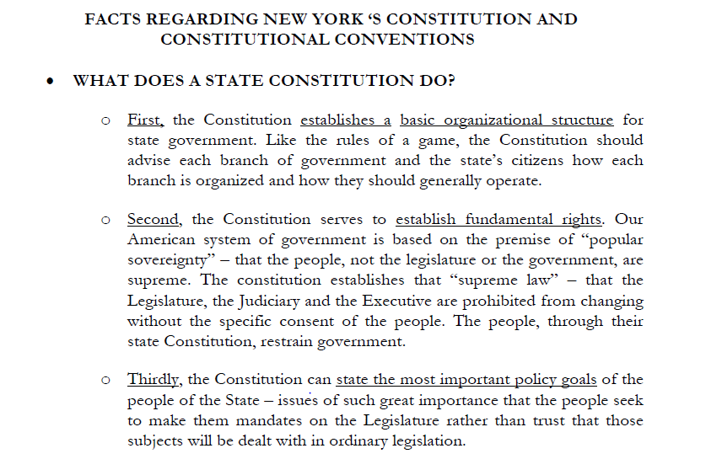
http://www.rochesterbusinessalliance.com

Slide 4
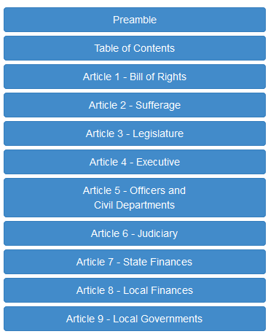
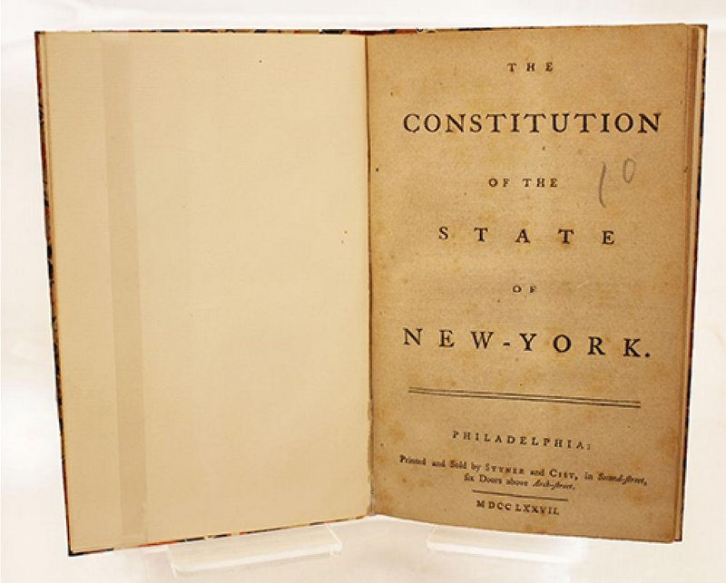
Now that you have exposed yourself to 3 different descriptions of the New York Constitution you know that it outlines the framework of government first, Right?
Hmm….That’s Strange. Why would New Yorkers put these two articles first?

Slide 5
Skimming Article I and II to find NY Values
Distribute pieces of Article I and II to each student in group.
Skim material to summarize what NYS Constitutional Framers valued and feared for their rights (timer 5 minutes) *** reminder while skimming readers to not need to read every word.
Group chooses scribe
Scribe asks for one value from each group member and records on worksheet

Slide 6
Task: Using group list of values discuss and come to consensus on the following
Amendments I and II of the NYS Constitution proves that New Yorkers value ________________________________________ ________________________________________
and/ or fear ______________________________ __________________________________________________________________________________

Slide 7
Let’s Discuss and complete prompt below as a class
“Framers of the NYS Constitution Valued _______________________________
and Feared
_____________________________. “

Slide 8
Ticket out the Door
Write your name on a Post it Notes and answer:
Do New Yorkers still hold similar values today?
Cite one example to support your claim

