Slide 1
Issue: Plastic Bag Ban
Background:
Environmentalists say banning Plastic Bags would decrease land and water pollution. They also cite that they don’t decompose.
If the bill were to pass, New York would join California and Hawaii in instituting bans.
Opponents say paper bags, an alternative to plastic, cost retailers “three to five times as much as single-use “plastic bags.”
A variety of bags would be exempted from the ban, including those that contain raw meat, fish or poultry; bags sold in bulk; those used in bulk packages of fruit and dried goods; those used for deli products; newspaper bags, trash, food storage and garment; and takeout food bags.
Scenario: A new Bill has been introduced in the Assembly and Senate that would Ban Plastic Bags in New York State.
Where is the Bill in the Legislative Process?
It is a Bill in the Assembly and Senate but has NOT passed through either chamber.
Your Stance: You want to see this become law!

Slide 2
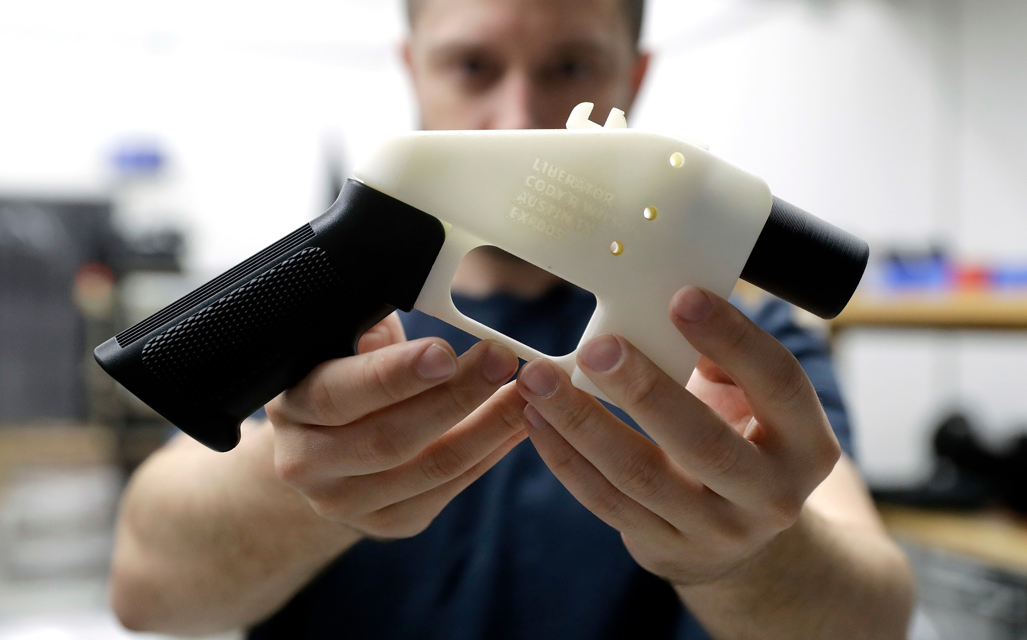
Issue: 3D Guns
Background: (according to NYPost.com)
Authorities are scrambling to get ahead of a potential flood of untraceable and undetectable 3-D printed guns in New York.
The bill would outlaw the manufacture of firearms without a gunsmith license, and require each major component of a weapon to be identifiable by a metal detector.
Under state law, any assault weapon — whether off the factory line or crafted in a 3-D printer — is illegal.
A 3-D printed pistol or revolver could conceivably be legal, New York State Police said, but it would have to be made by a licensed firearm owner, include a serial number, and be registered with local authorities.
Long guns that don’t qualify as assault weapons, however, don’t require licenses to own upstate — and officials said 3-D printed guns in that style would be no exception.
In New York City, where gun registration regulations differ from upstate communities and are handled by the NYPD, licenses for 3-D guns have not and will not be issued.
Scenario: 3D Guns enable anyone to print any type of gun. This could help people get around the State’s gun laws.
Where is the Bill in the Legislative Process?
A Bill has passed the Assembly to ban 3D guns but has not passed the Senate.
Your Stance: You want the Senate to pass the Bill to ban 3D guns and the Governor to sign it into law.

Slide 3
Issue: Ban on Soda Taxes
Background:
Sugary drinks are considered to be on of the leading causes of obesity, diabetes, and other health problems.
Local communities (Counties, Towns, Cities) in other states have chosen to curb consumption of sugary drinks by raising taxes to be paid when purchasing the drinks.
Many consumers and beverage companies say these types of taxes are unfair to its customers and will hurt their profits.
New York State would ban any new tax on Sugary Drinks, including soda, in the state until the year 2020, while the state further studies if there should be a state tax.
Scenario: New York State is threatening to pass a Bill that would forbid local towns and counties from raising taxes on Soda and other sugary drinks.
Where is the Bill in the Legislative Process?
The Bill has passed the Senate but has not passed the Assembly.
Your Stance: You want to PREVENT this Bill from becoming law so local towns can tax.

Slide 4
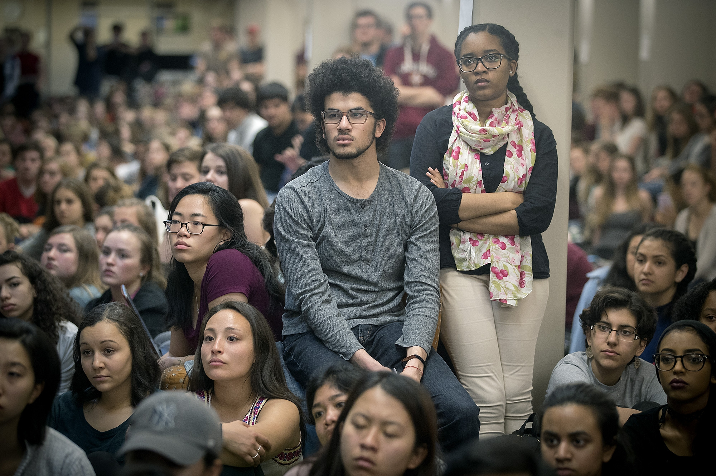
Issue: Boycotting Allies
Background:
Many students exercise their First Amendment rights on campus through actions like protesting and boycotting.
This Senate Bill would penalize New York State Universities for allowing their students to boycott our nation’s allies by withholding funding it normally gives that University.
The purpose of this bill is to prevent negative attention and loss of profits that boycotts could bring to our allies.
This bill had drawn criticism for what some sahy is New York State limiting the First Amendment rights of students on campus.
Scenario: The Senate has passed a bill that would take away a College’s funding if their students boycott our Country’s Allies.
Where is the Bill in the Legislative Process?
It has passed the Senate but has NOT passed the Assembly.
Your Stance: You believe this is a Free Speech Violation and want to PREVENT the Bill from passing the Assembly becoming law!

