Slide 1
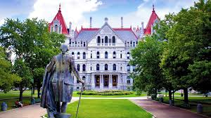
NEW YORK STATE-Government in Albany
Created by Jennifer WIlson, League of Women Voters; edited for lesson by Jody Butts

Slide 2
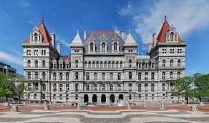
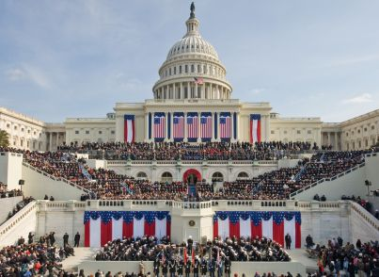
OUTLINE
State versus Federal: What Are the Differences
The Legislature: How Our Government Operates
The Executive: How The Governor Influences Policy

Slide 3
 | New York State | Federal Government
Executive | Governor (4 year term, no term limit) Lieutenant Governor (nominated, on same ticket as Governor) | President (4 year term, 2 term limit) Vice-President (nominated, on same ticket as President)
Legislative Bodies | Assembly (2 year term, no term limits) 150 Assembly Members Senate (2 year term, no term limits) 63 Senators | Congress (2 year term, no term limits) 535 Members of Congress Senate (6 year term, no term limits) 100 Senators
Judicial | NYS Court of Appeals is Highest NYS Appellate Court is Middle NYS Supreme Court is Lowest | Supreme Court is Highest
Authority of Dept. of Justice | Attorney General (Elected by People, 4 year term) | Attorney General (Appointed by President)
Fiscal Authority | Comptroller (Elected by people, 4 year term) | Secretary of United States Department of the Treasury (Appointed by President)

Slide 4
New York State Constitution | U.S. Constitution
Direct election of governor | No direct election of President (Electoral College)
Direct election of both houses of legislature since 1777 | U.S. senators not directly elected until 1913 amendment
Elected Governor/LG, Comptroller, Attorney General | Only nationwide elected officers at national level are President/VP
Elected trial court judges (some appellate judges) | No elected judges at any level of federal judiciary
Direct vote on constitutional amendments/convention calls | No direct participation in constitutional revision process

Slide 5
National Government | State Government
* Print money * Regulate interstate (between states) and international trade * Make treaties and conduct foreign policy * Declare war * Provide an army and navy * Establish post offices * Make laws necessary and proper to carry out these powers | * Issue licenses * Regulate intrastate (within the state) businesses * Conduct elections * Establish local governments * Ratify amendments to the Constitution * Take measures for public health and safety * May exert powers the Constitution does not delegate to the national government or prohibit the states from using
In addition to their exclusive powers, both the national government and state governments share the power of being able to:
Collect taxes
Build roads
Borrow money
Establish courts
Make and enforce laws
Charter banks and corporations
Spend money for the general welfare
Take private property for public purposes, with just compensation

Slide 6
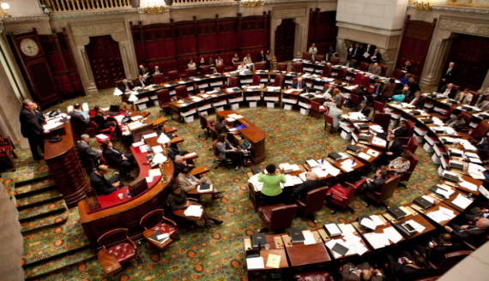
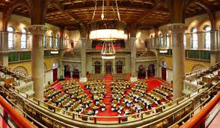
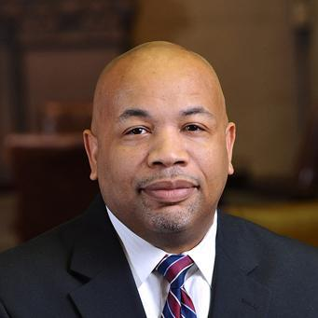
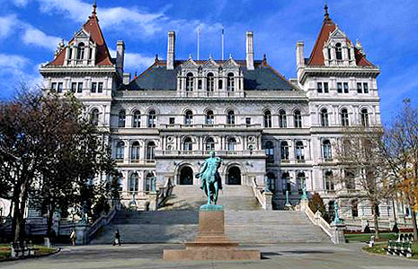
THE LEGISLATURE: HOW OUR GOVERNMENT OPERATES

Slide 7
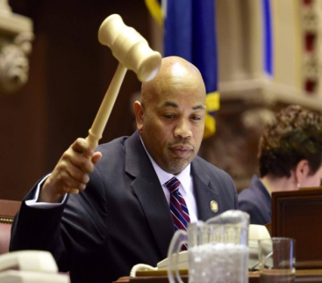
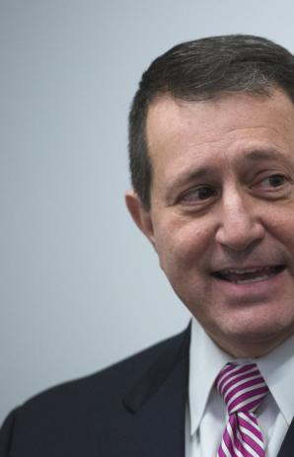
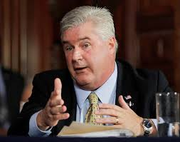
NEW YORK STATE ASSEMBLY
150 Members
106 Democratic Members
43 Republican Members
1 Independent Member
Leader of Assembly is Speaker
Assembly Speaker
Majority Leader
Minority Leader

Slide 8
NEW YORK STATE SENATE
63 Senators
31 Democrats
1 Additional Democrat sits with Republicans
31 Traditional Republicans
President of the Senate is Lieutenant Governor
Temporary President is Majority Leader
Minority Leader

Slide 9
ASSEMBLY & SENATE
Senate:
63 Senators
31 Democrats
1 Additional Democrat sits with Republicans
31 Traditional Republicans
President of the Senate
Temporary President/Majority Leader
Minority Leader
Assembly:
150 Members
106 Democratic Members
43 Republican Members
1 Independent Member
Leader of Assembly is Speaker
Assembly Speaker
Majority Leader
Minority Leader

Slide 10
THE EXECUTIVE: HOW THE GOVERNOR INFLUENCES POLICY

Slide 11
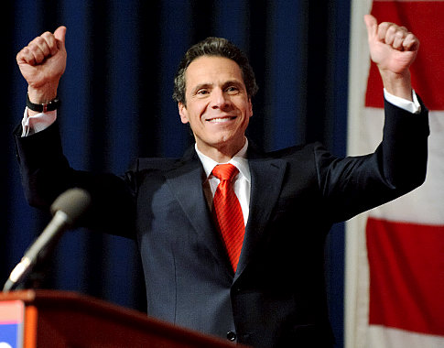
HOW THE GOVERNOR ASSERTS HIS AUTHORITY
Proposes State budget
Can propose legislation but needs to have actual members sponsor
Can sign or veto legislation
Manages all State Departments and Agencies (Executive Branch)

Slide 12
THE LEGISLATIVE PROCESS: HOW A BILL BECOMES A LAW

Slide 13
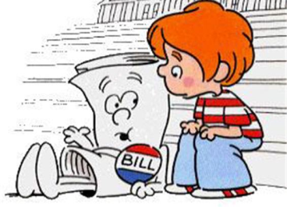
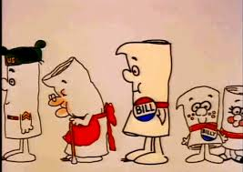
HOW A BILL BECOMES A LAW
-Bill is Introduced my member
Bill is given a number
Bill put into committee
Committee votes on bill
Bills is referred to another committee
Or
Bill Goes to Floor
Whole House Votes
Bill is delivered to the other house
Process repeats
Bill passes
Bill is Signed by Governor
Or
Governor Vetoes Bill
Bill can become law if two-thirds of the members of each house vote to override the Governor's veto.

Slide 14
NYS Judiciary
NYS Trial Courts – trial level courts of general jurisdiction
In NYC – Civil and Criminal Courts of NYC
Outside NYC – City, District, Town and County Courts
Both NYC and outside NYC – NYS Supreme Court - elected to 14-year terms
NYS Appellate Division of Supreme Court (intermediate appellate court))
4 courts: Manhattan, Brooklyn, Albany and Rochester
Chosen by the Governor from among those elected to the State Supreme Court for at least 5 years or end of 14-year term
NYS Court of Appeals (highest court in NYS)
Sits in Albany
Chief Judge and six Associate Judges appointed by Governor and confirmed by State Senate to 14-year terms

Slide 15
How do the courts affect public policy?
Rule laws unconstitutional
Decisions that force legislature to act
Decisions that can act as laws

