Slide 1
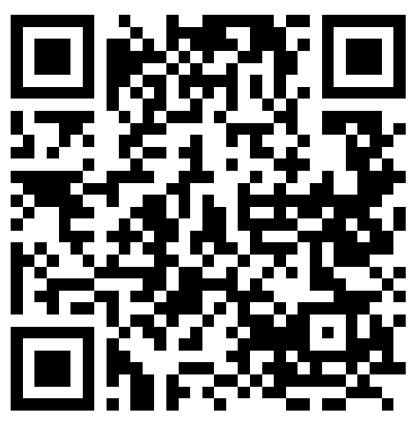
How & Why Not to Do It All Presented by: Your Local League Support Committee
Jane Colvin, Pattie Garrett, Judie Gorenstein, Margie McIntosh, Joy Rosenzweig, Kathy Stein, and Regina Tillman
LWVNYS: Call or email Laura or the members of the Local League Support Committee
LWV PRESIDENTS’ GOOGLE GROUP: Contact Laura to join
LWVNYS Website: Membership/Leadership Resources
lwvny.org/membership-leadership-resources/
LWVUS Website: League Management https://www.lwv.org/league-management/policies-guidance/membership-leadership-development-mld-handbook
TIPS, RESOURCES, AND SUPPORT

Slide 2
CASE STUDY: LWV of Somewhere in NYS
Caroline feels a migraine coming on. She loved the idea of being president of her local League but is now having some doubts. It’s the middle of her first year in office and her responsibilities seem endless. Next year is an election year, with hotly contested races at the local, state, and national levels – perfect opportunities to engage members to do the League’s important work. Only she doesn’t know how to get everything done. She knows she should delegate some of her tasks, but no one seems interested or, frankly, qualified to do them properly; it’s just faster to do everything herself.
Caroline’s board has fallen into a comfortable routine. Though highly experienced, many members, having held their current roles for eons, are pretty apathetic - except when others try to modify or replace their tried-and-true activities and procedures. Board and ad hoc committees are meeting, which is the good news. But, according to reports the committee chairs gave at the last meeting, VS is enthusiastically planning more programs than they can possibly handle.
The League’s Treasurer/Secretary and VP are rays of sunshine. Grants have come through for VR and GOTV events, and new membership is picking up due to the intense nature of the upcoming election season. One of the new members is enthusiastic and brimming with great ideas. Unfortunately, she is a working mom with very little spare time.
Caroline has been praised for her listening skills and when called upon, inspiring communication. She has a year and a half left in her term but is worried her Nominating committee will have a tough job recruiting someone to take her place. Given that she only has a few months before election season kicks into gear, what steps can Carolyn take to strengthen her League and put an end to her headaches (or at least alleviate some of them)?
What are her most pressing problems?
What are her resources?
How might they be utilized most effectively?

Slide 3
CREATE A LEADERSHIP LADDER
THE ASK
At every opportunity
Ask others to attend a League program
Ask others to join
Ask members how they want to get involved
Ask engaged Leaguers to take leadership positions
Attract, Engage, Develop
Nominating Committee, board and active members identify potential leaders
Incorporate leadership development into all programs and activities
Mentor and prep members to be leaders
Choose a leadership model that works for your League

Slide 4
DEVELOP LEADERS THROUGH EVENTS
Before the Event
Who else can you engage to plan this event?
Is there someone who can shadow the organizers?
Are there some small tasks to engage a few potential new leaders?
Who else can you invite to this event?
At the Event
Can you highlight the personal value of being a League leader?
How can you acknowledge volunteers and leaders publicly?
Is there someone who can shadow those in charge of the event?
Did you note which League members attended and showed interest in the topic/program?
After the Event
Did you thank League leaders?
Did you ask the organizers what else they needed (training, resources, volunteers)?
Did you forward the list of attendees to the nominating committee?
Did you observe an area for training, mentoring or other areas of organizational growth?
Are there notes/records in place for the next leader for this event?
Did you follow up with anyone you invited?

